Slide 1



Stony Brook University
School of Nursing
Master of Science in Nursing Leadership
Advanced Certificate in Nursing Leadership
Virtual Information Session
Paula Timoney, DNP, APRN, NNP-BC
School of Nursing

Slide 2

About our School
•One of 64 SUNY campuses
•One of only four University Center campuses in SUNY
•One of eleven schools at Stony Brook University
•One of five schools at Health Sciences Center
•US News and World Report Rankings:
#77 National Universities (tie)
#120 Best Value Schools (tie)
#31 Top Public Schools (tie)
•2021 QS US University Ranking: #39
•Wall Street Journal Ranking:
#1 Public University in NY
Stony Brook University - School of Nursing

Slide 3

About Our School
•Accredited by Commission of Collegiate Nursing Education (CCNE)
•40 Full-Time and Part-Time Faculty
•92% of Faculty hold Doctoral Degrees
•Faculty are Clinical Experts in their Field
•Faculty are Active Researchers
•SON Graduates Highly Employable
School of Nursing

Slide 4

Why choosing a program within Stony Brook School of Nursing?
Predominantly online programs
New York State tuition as NYS Residents
Stony Brook University’s reputation
Seats for all required classes are guaranteed.(You cannot be closed out of a required course.)
School of Nursing

Slide 5
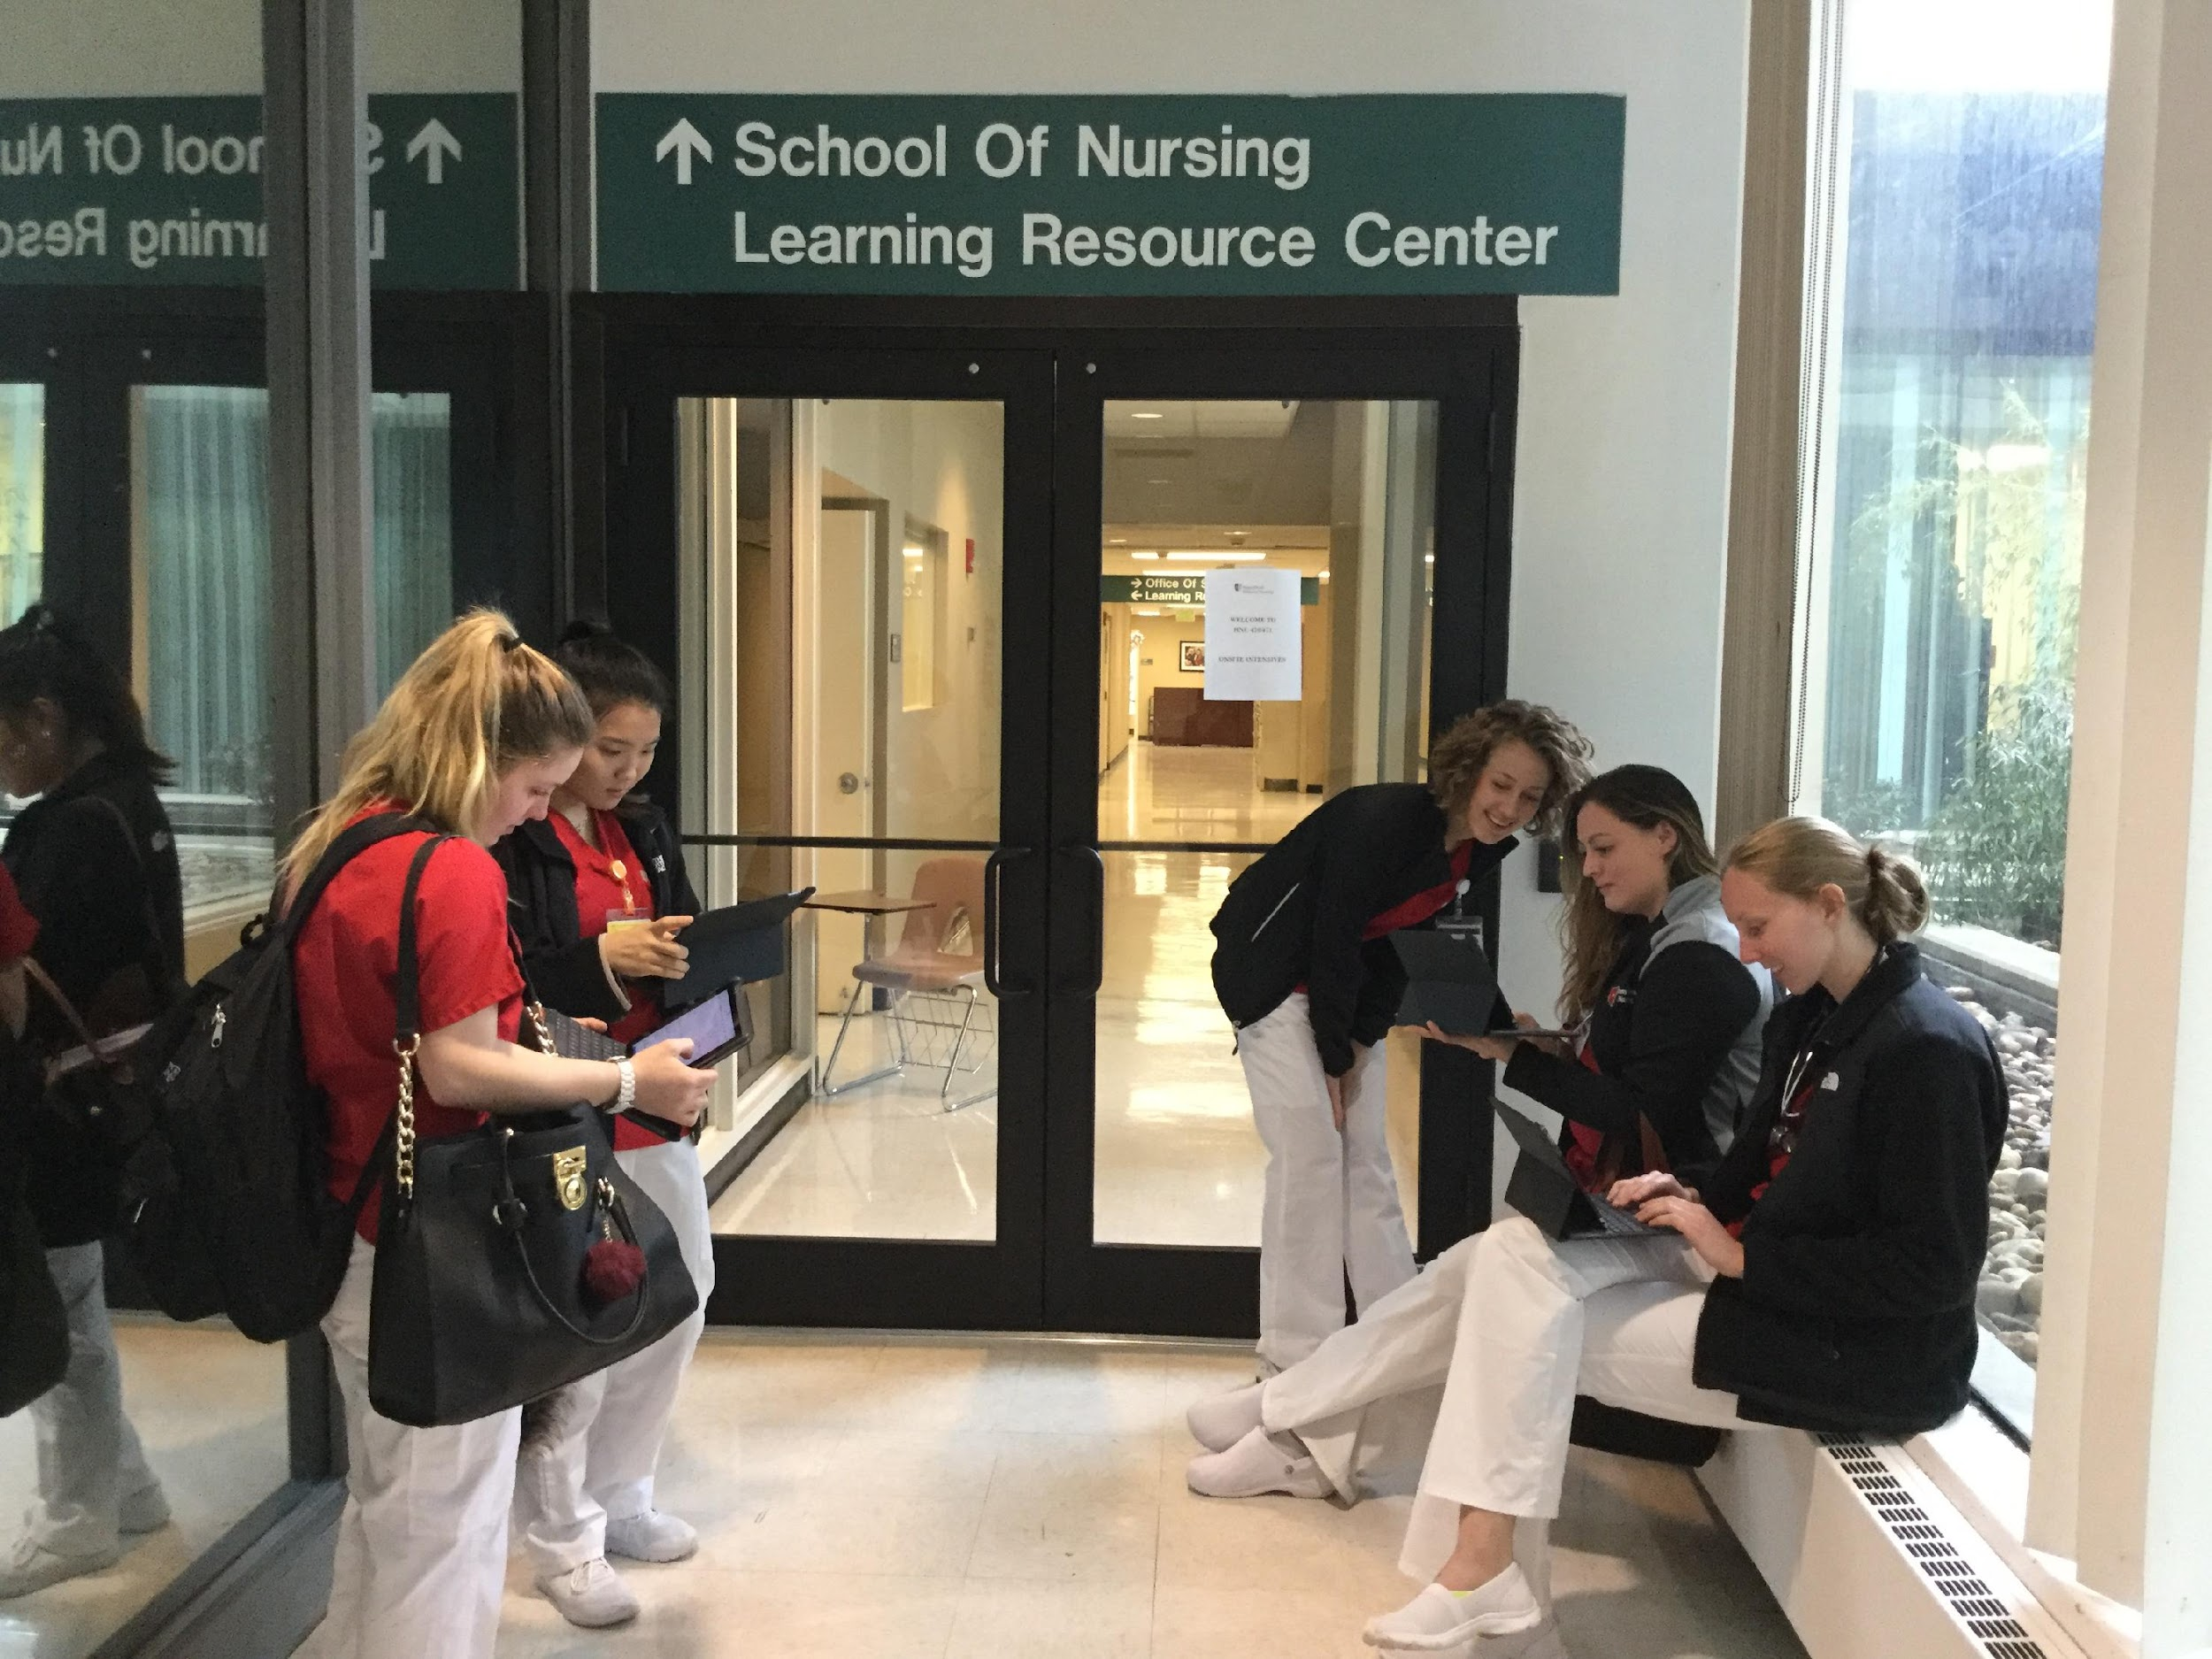
The Master of Science in Nursing Leadership Program prepares nurses as leaders to assume leadership positions across all levels of nursing and health care continuum. This program is offered as cohort program using a blended model with scheduled on-site immersions and curriculum delivery via a computer mediated modality.
36 Credits Online Didactic
2 Years in Length
On-Site Intensives
180 Clinical Hours
Master of Science in Nursing Leadership

Slide 6

Within this program, there are:
–3 Core Courses
•Organizational Leadership and Role Transformation (3 credits)
•Quality Improvement, Safety, and Health Care Technologies (3 credits)
•Health Care Policy and Advocacy (2 credits)
–2 Research Courses
•Nursing Research & Evidence-Based Practice I (3 credits)
•Nursing Research & Evidence-Based Practice II (3 credits)
–5 Business/Leadership Courses
–2 Clinical Courses
•Advanced Theory & Practice in Nursing Leadership I (4 credits)
•Advanced Theory & Practice in Nursing Leadership II (3 credits)
Master of Science in Nursing Leadership - Curriculum

Slide 7

The Advanced Certificate program in Nursing Leadership will prepare nurse leaders to assume leadership positions across all levels of nursing and health care continuum. Students will participate in scheduled on-site immersions and curriculum will be delivered via a computer mediated modality
Students admitted to the Advanced Certificate Program will be advised regarding the courses that have to be taken and provided with a pathway to complete the Certificate.
Advanced Certificate in Nursing Leadership

Slide 8

All students are accepted on a part-time pathway
The two-year, part-time pathway was developed for working RNs
Why a Part-time Pathway?

Slide 9

On-Site Intensives
•Two to four on site sessions per semester per course (Core courses are usually offered fully online)
On site sessions take place on weekdays from 9AM to 12PM and/or 1PM to 4PM (times may be adjusted per Faculty request)
•Collaborative Learning Environment
•Team Based Learning
•Guest Lecturers
•Development of a Project Proposal
On- site Intensives

Slide 10
Process for Clinical Experiences
Students in the Master’s in Leadership program complete 90 hours per clinical course (a total of 180 hours).
Students are required to network to locate their own clinical placements and preceptors.
Once a suitable site is identified, students submit a clinical placement request form for processing.
The Office of Clinical Placements facilitates the processing of clinical placement requests and contracts for all clinical affiliations within the master’s and advanced certificate programs.
The Office of Clinical Placements works collaboratively with faculty to secure clinical placement sites for students.
Clinical Placements

Slide 11

The online application will be available every year in August under Quick Links in our website
https://graduateadmissions.stonybrook.edu/apply/
Application deadlines can be checked in our website https://nursing.stonybrookmedicine.edu/academic
Application and Deadline

Slide 12

Master of Science in Nursing Leadership Admission Requirements
•Bachelor of Science degree with a major in nursing (applicants with non-nursing bachelor degrees will need to submit a Clinical Practice Portfolio)
•Minimum of one year's recent relevant experience (preferred)
•Unofficial transcripts from all college/universities attended
•Cumulative grade point average of at least 3.0
•Current professional Registered Nurse license
• Three letters of recommendation
• Three credit undergraduate course in Statistics
• Meet all Technical Standards for Admission and Retention
Please visit our website for additional information:
https://nursing.stonybrookmedicine.edu/nursingleadershipmaster
Admission Requirements – Master of Science in Nursing Leadership

Slide 13
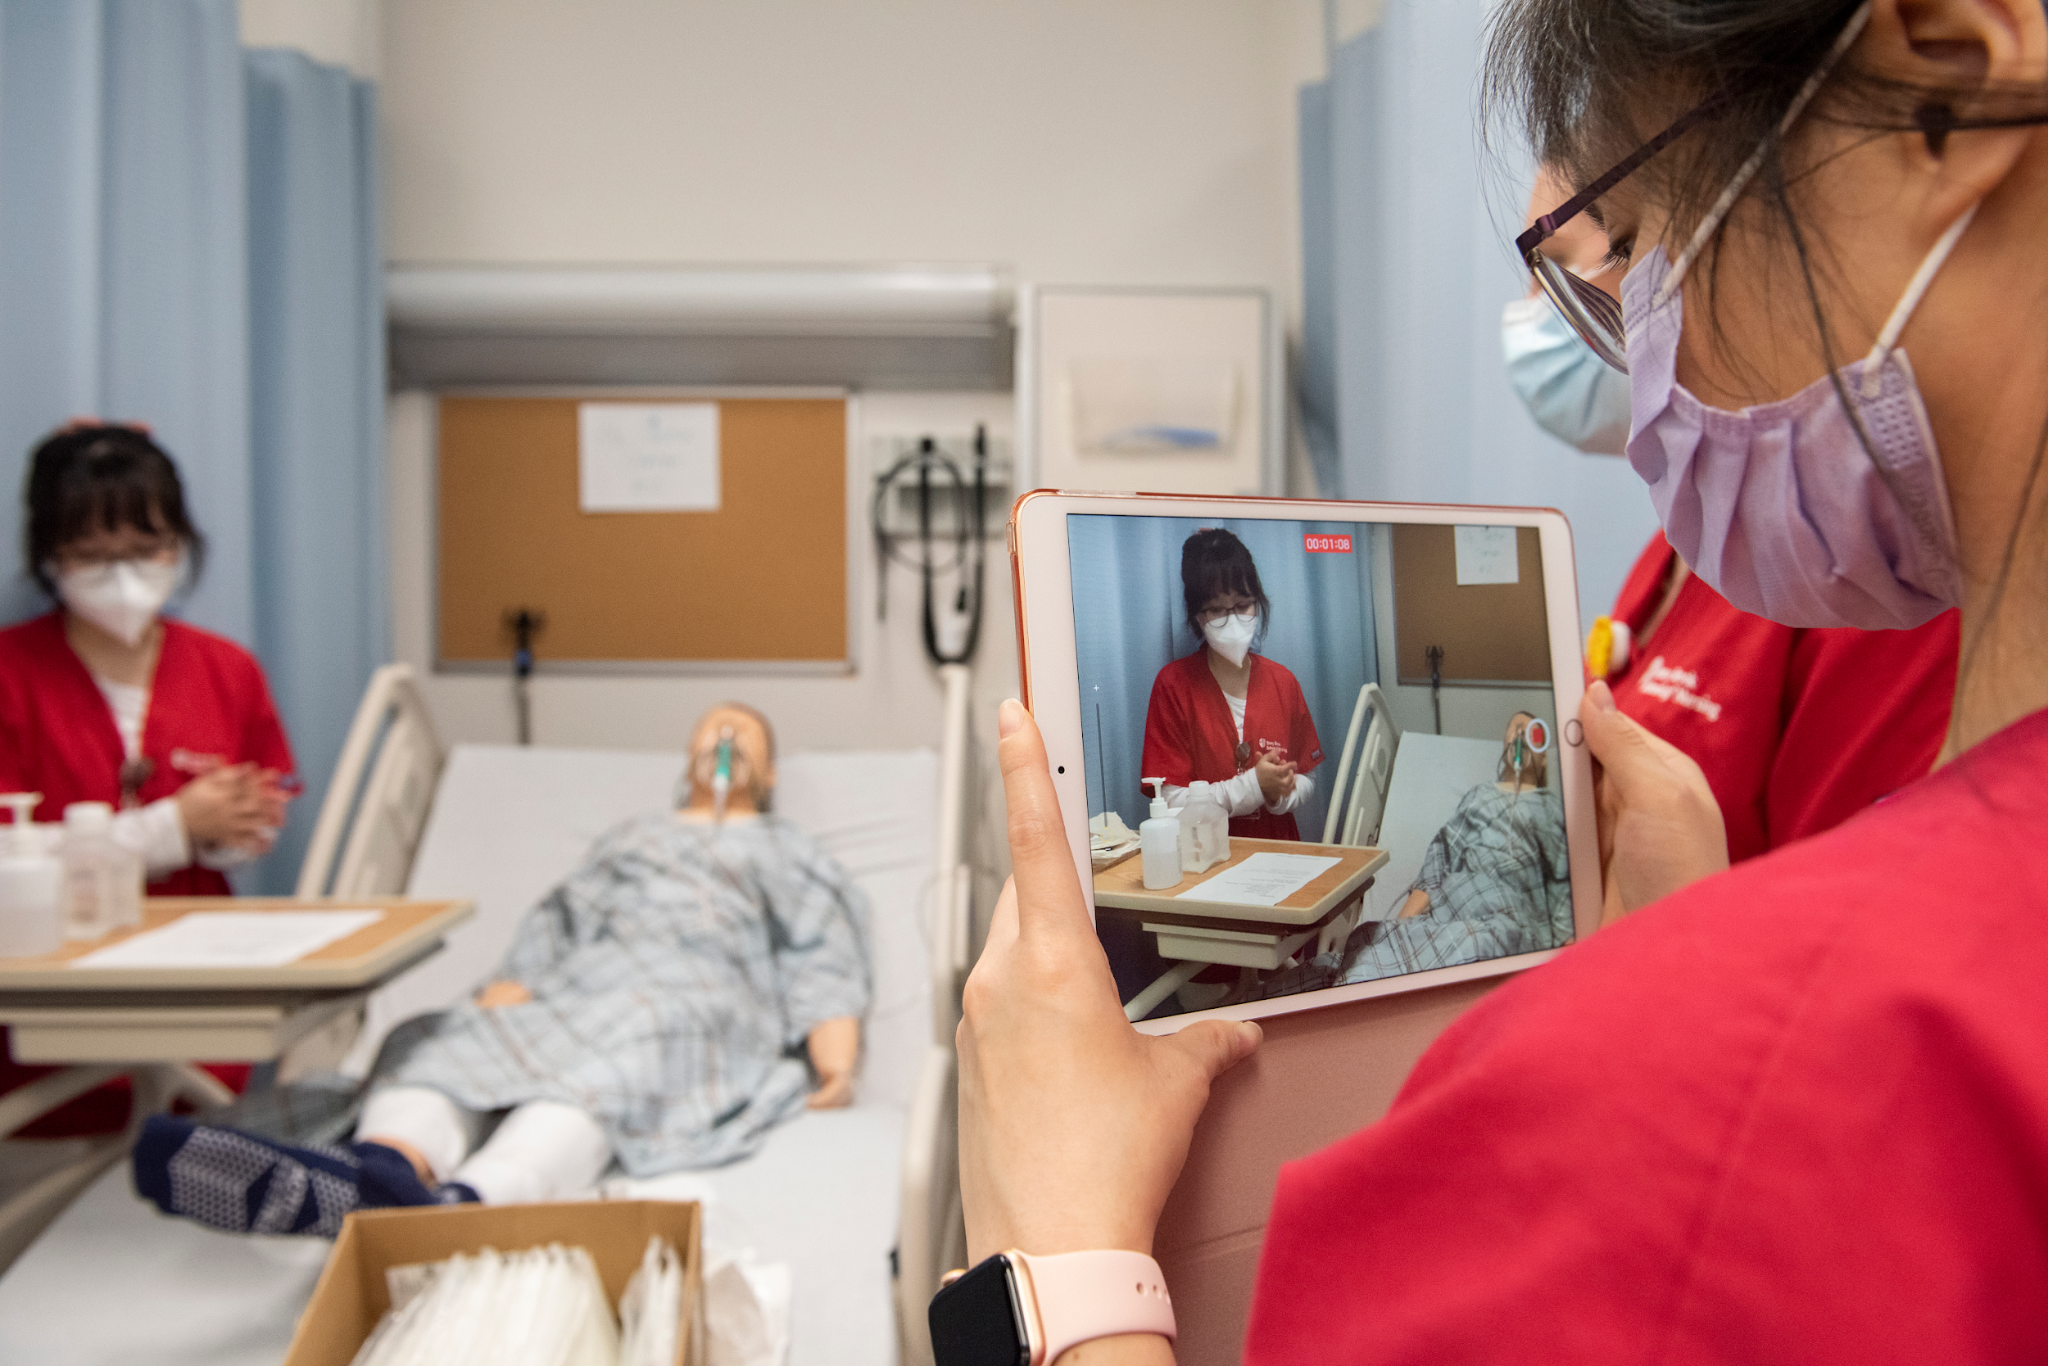
* Clinical Practice Portfolio - Registered Nurse applicants to a master’s program with a non-nursing bachelor's degree are required to submit a clinical practice portfolio to be evaluated for baccalaureate-level nursing competencies upon conditional admission once they have been admitted to a program. A non-refundable fee of $300 is required for the portfolio evaluation. Upon successful completion and approval from the Program Director and the Chair of the Department of Nursing Organization and Leadership of the portfolio, the student will be matriculated to the program. If the portfolio does not meet academic standards, the student cannot progress in the program.
Clinical Practice Portfolio

Slide 14
Advanced Certificate in Nursing Leadership
Admission Requirements
Master’s or Doctoral Degree from an accredited nursing program
A minimum of one year’s recent relevant experience (preferred)
Unofficial transcripts from all college/universities attended
Cumulative grade point average of at least 3.0
Current professional Registered Nurse license
Three online letters of recommendation
Three credit undergraduate course in Statistics
Meet all Technical Standards for Admission and Retention
Please visit our website for additional information:
https://nursing.stonybrookmedicine.edu/nursingleadershipcertificate
Admission Requirements – Advanced Certificate in Nursing Leadership

Slide 15
Unofficial transcripts from all colleges/universities ever attended must be uploaded onto the electronic application (must be readable transcripts)
Current curriculum Vitae/Resume
Current and maintained RN License
References – submitted electronically via the online application
  Email addresses of 3 professional references
  Vary your selection
  Family and friends are not acceptable
All outstanding preadmission coursework must be posted on the official transcripts and the official transcripts submitted after acceptance into the program. However, new nursing graduates will be given additional time to submit their school of nursing transcripts.
Completion of all preadmission coursework is required prior to starting the program.
Prerequisite courses do not age out
Required grade is C or higher
Personal statement/essay is required
You may be interviewed as part of the admission process.
$100 Application fee
The Admissions and Academic Standards Committee and the Dean of the School of Nursing make final decisions regarding the selection of incoming classes
Application Requirements

Slide 16
The Leadership programs admit students only in the Summer Term
Summer Term begins at the end of May
Mandatory Onsite orientation is usually scheduled for mid-April.
Accepted students will receive 6-8 weeks notification of the orientation date.
ORIENTATION IS MANDATORY
Admission Date/Orientation

Slide 17
Additional Requirements Upon Admission
RN Student Malpractice Insurance Required
Official transcripts from all colleges/universities attended
Transcripts from foreign institutions must be evaluated for transfer equivalency credits by an NACES accredited evaluation service, such as the World Education Services (WES) http://www.wes.org
All newly admitted students will receive an email from the SON Required Documentation email address, shown below, with detailed instruction to utilize the required CastleBranch web-based software system. This system requires a one time fee and is where students will upload and manage required documents."son_required_documentation@stonybrook.edu"
Requirements Upon Admission

Slide 18

Click on link below and select “Graduate” for the most recent per credit cost:
https://www.stonybrook.edu/commcms/bursar/tuition/
Please note that other fees and charges apply.
Tuition

Slide 19

Financial Aid
Please contact the Financial Aid Office at Stony Brook University:
Phone: 631-632-6840
Email: finaid@stonybrook.edu
Website: https://www.stonybrook.edu/commcms/finaid/
Financial Aid

Slide 20

  For additional information please contact:
  silvana.jara@stonybrook.edu
Additional Information- Questions

Slide 21

Go Seawolves!

